Slide 1
Statistics 101.
A non-statistician, MD’s view
Monday, June 26, 2017

Slide 2
Why discuss statistics ?
To understand research studies in medical journals
To design and then analyze research studies
To help explain research studies to our patients
(To answer a few questions on board examinations)

Slide 3
What is the basis of statistics?
Data Collection (sampling)
  “garbage in, garbage out”
Assumptions about the data sample collected
  e.g., normality assumption
Straightforward math computations performed on paper or a calculator or more complex modelling with computerized computations
Free websites or for-purchase programs and software

Slide 4
Types of research studies/trials that require statistical analysis
Cohort study: all patients meet some criteria
Case-Control study: all cases meet a definition and controls don’t meet it
  Controls are ‘matched’ with cases for age, gender, and other matchable variables
Randomized trials:
  Placebo-controlled or sham-treatment controlled
    may be unblinded or blinded (single or double-blinded)
  Active-treatment controlled
    may be unblinded or blinded ( single or double-blinded)
    often a phase 3 trial; may be non-inferiority study design (Statistics 102)
Meta analysis: pooled studies of the same condition, although the definitions of the condition and the outcome(s) of interest may vary across studies that are pooled

Slide 5
Types of Variables in Clinical Research Studies
CONTINUOUS
  AGE
  BP
  AST, CRP, glucose, etc.
  HEIGHT
  WEIGHT
  BMI
CATEGORICAL
  GENDER
  RACE
  OBESE
  CURED
  PREGNANT
  MI
  OLDER

Slide 6
Basic statistical terms for a data set
A data set: test scores on a 20-question exam in 21 students {# of correct answers: 2,13,4,20,18,6,6,11,9,12,5,4,8,18,10,11,4,20,16,7,5}
Scores from lowest to highest: 2,4,4,4,5,5,6,6,7,8,9,10,11,11,12,13,16,18,18,20,20
Range: the extreme values (min, max) = 2,20
Median: the middle value (ignoring all other values), thus dividing the population into 2 subgroups; 11th value of 21 =9
  Quartiles: divided into 4 groups. Percentiles: into 100 groups
Mean: the average of all values=10, often cited with the standard deviation of the mean (if data are thought to be normally distributed)

Slide 7
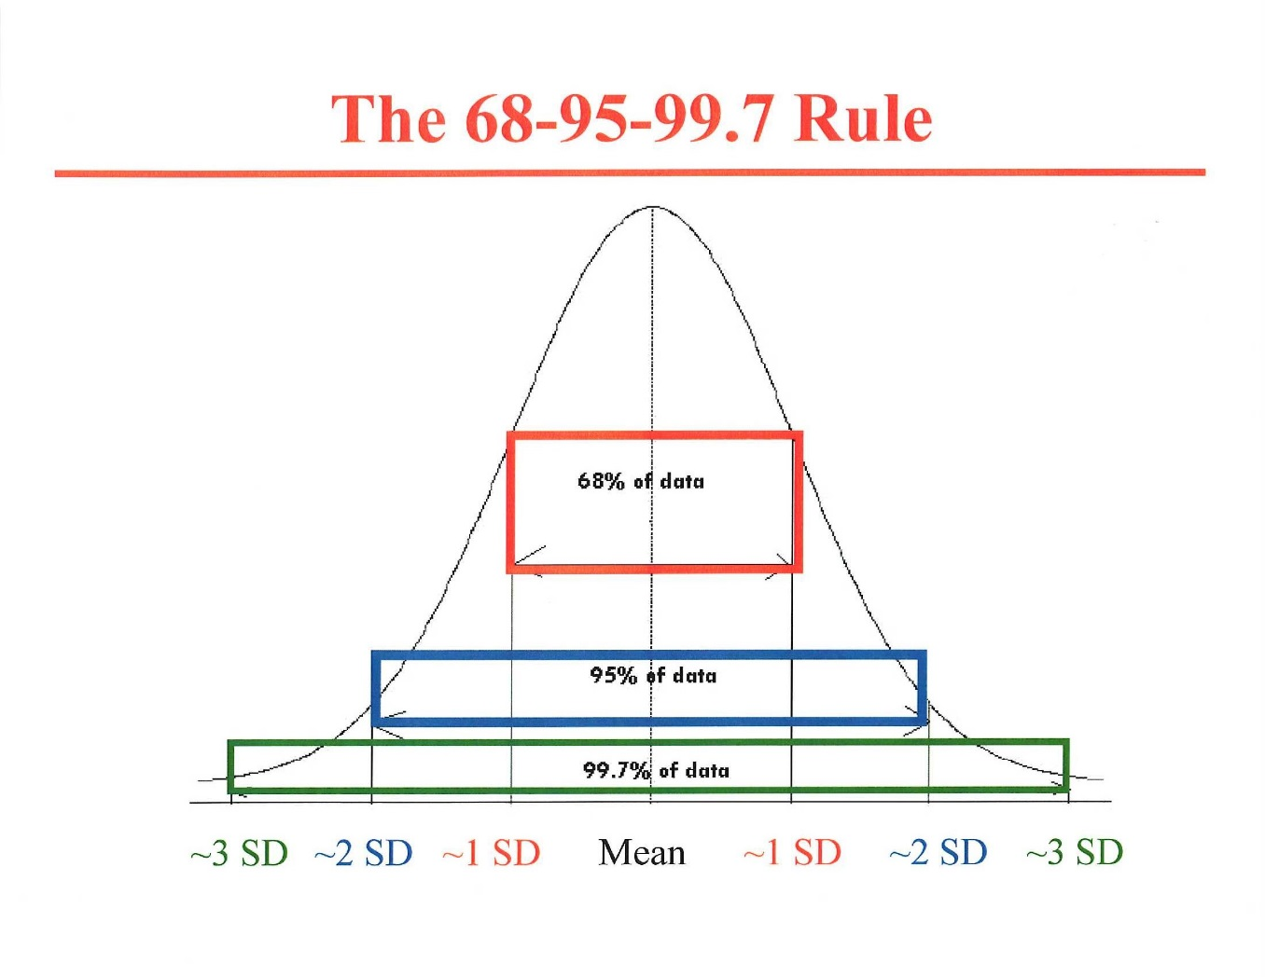
Normal, bell-shaped Gaussian distribution
-1.96
1.96

Slide 8
N=237

Slide 10
K⁺ Skewness
Skewness = +.555
Skewness of normal distribution = 0
Standard error skewness (SES) = .158
Z = Skewness/SES= .555/.158 = 3.45
Critical value for Z = 1.96 (p=0.05)
P=0.005

Slide 11
Standard deviation of the mean
A statistic to deal with values higher than the mean and those lower than the mean, quantitating the degree of spread of the data (variance)
Measures the average difference among the values in the data set
  SD= √(Σ(differences from the mean)² /n-1)

Slide 12
Example of standard deviation calculation
Values in data set | Difference from mean (d) | Difference² (d²)
12 kg | +2 kg | 4 kg²
10 kg | 0 kg | 0 kg²
5 kg | -5 kg | 25 kg²
15 kg | +5 kg | 25 kg²
8 kg | -2 kg | 4 kg²
Mean,10 kg Median, 10 kg Range, 5-15 kg | Differences can be + or -, large or small | ∑d²=58 kg²
SD= √(Σ(differences (d) from the mean)² /n-1)
d²/(n-1)= 58 kg²/4=14.5 kg²
SD= √14.5 kg² = 3.8 kg
Mean ± SD = 10 kg ± 3.8 kg

Slide 13
Were our 21 students’ test scores normally distributed or skewed?
Test scores
METHOD: Excel spread sheet
ANSWER: skewed (≠0)
LESSON: do not apply a parametric test, such as a Student’s t test, to compare test results with another class of students, based on an assumption of a normal (Gaussian) distribution
2
13
4
20
18
6
6
11
9
12
5
4
8
18
10
11
4
20
16
7
5
10.0 | mean
9 | median
5.7 | sd
0.539311 | skewness
21 | n=
A1
A21

Slide 14
Why it matters whether data are normally distributed or not?
To be able to apply the proper test for significance.
Example: Differences in SBP between placebo and active drug in 12 patients given each Rx for 2 mos. in random order
  -12, 0, -8, -9, -10, -6, -11, +1, -4, -7, -8,and -5 mm Hg
Paired t test based on assumption of normality (skewness, kurtosis ≈ 0): P<0.0001
Wilcoxon’s signed rank test based on non-normality assumption: P=0.0004
BP change
-12
0
-8
-9
-10
-6
-11
1
-4
-7
-8
-5
-6.0 | mean
-7.5 | median
4.1 | sd
0.716341 | skewness
B1
B12

Slide 15
Some important statistical concepts
Confidence intervals (usually reported as 95% CIs)- based on normality assumption (1.96 SD or SEM)

Slide 16
CONFIDENCE INTERVALS
H. pylori eradication/NSAID study* of 100 patients, with the categorical outcome of ulcer or no ulcer:
♦5 of 51 (10%, or .10) Hp+ pts. who received antibiotic therapy developed endoscopic ulcers when given the NSAID for 8 weeks.
♦15 of 49 (31%, or .31) Hp+ pts. who did not receive antibiotic therapy got endoscopic ulcers when given the NSAID for the same period of time.
  What are the 95% confidence intervals for these observed outcomes (estimates)?
*Lancet 2002; 359:9-13

Slide 17
95% Confidence Intervals (CIs)
The observed proportion, p, of those who got ulcers in each group is an estimate of the true proportion.
However, from the estimate p we can be 95% confident that the actual rates ranges from L to U, with p in the center of this interval from L to U.
L and U are the lower (L) and upper (U) margins of the 95% confidence intervals for p.
L
U
p

Slide 18
95% Confidence interval (CI) formula for a proportion, p
95% CI for p = p ± 1.96√ [(p)(1-p)/n]
I. The larger the n, the narrower (more precise) the CI, as n is in denominator.
II. The further p is from 0.5, the narrower (more precise) the CI, as (p)(1-p) is in numerator.
If p=.5, .5 x.5=.25, √=.5
If p=.9, .9 x .1 =.09, √=.3
If p=.99, .99x.01=.0099, √=.0995≈.1

Slide 19
5 of 51 (p₁=10%, or .10) of the antibiotic group got ulcers when exposed to NSAID
  95% CI for p₁ =.10 ± 1.96√(.1)(.9)/51=.10±.08=[.02, .18], or 2%,18%
15 of 49 (p₂=31%, or .31) of the placebo- group got ulcers when exposed to NSAID
  95% CI for p₂ =.31±1.96√(.31)(.69)/49 =.31±.13=[.18,.44], or 18%, 44%
H. pylori/NSAID study
Note: the two 95% CIs for p₁ and p₂ hardly overlap, which means that differences
are unlikely to be due to chance.

Slide 20
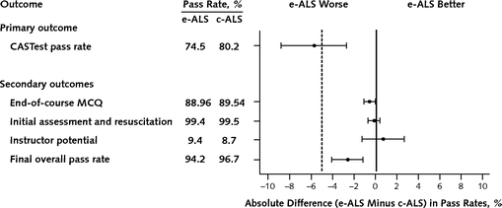
Analyzing graphs with 95% CIs
Teaching Advanced Life Support (ALS):
electronic ALS (e-ALS) vs.
conventional classroom ALS (c-ALS)
95% CI of a difference

Slide 21
95% CI of a difference
Two doses of HCTZ are compared in 400 patients with mild systolic hypertension, 198 randomly treated with 12.5 mg and 202 with 25 mg. Mean SBP at the beginning of the study was 144 mmHg in both groups.
After 8 weeks, SBP was 138±8 mmHg in the 12.5 mg HCTZ group and 135±9 mmHg in the 25 mg HCTZ group (mean±SD). What is the 95% CI of this 3 mm Hg difference, and does it include (overlap with) zero?
http://www.graphpad.com/quickcalcs/index.cfm
Difference = 3 mmHg, with 95% CI of 1.32 to 4.68 mmHg

Slide 22
Some important statistical concepts
Confidence intervals (usually reported as 95% CIs)
Absolute and relative risk reductions

Slide 23
Absolute risk reduction (ARR) and the 95% CI of this difference
The ARR with antibiotic therapy was 31%-10%= 21%.
The 95% CI of this risk reduction, p₁-p₂ =
(p₁-p₂) ± 1.96 √ (p₁)(1-p₁)/n₁+ (p₂)(1-p₂)/n₂) = 21% ±15%, or [6%, 36%].
The ARR with antibiotics is somewhere between 6% and 36%, with 95% confidence.
This CI does not overlap 0 and thus unlikely due to chance.
Free calculator: http://vassarstats.net/prop2_ind.html

Slide 24
Relative Risk Reduction (RRR)
RRR=ARR with the intervention/risk with placebo (or control)..
In this example, RRR= 21%/31% = 68%.
  Treat 1,000 pts. with NSAID→ 310 ulcers (31%)
  Treat 1,000 pts. with NSAID + Abs→ 100 ulcers (10%)
  Antibiotic use prevented 210 ulcers , and 210/310 = 68% = RRR.
  Antibiotic use reduced the # of ulcers from 310 to 100, or to 32% of expected, a RRR of 68%.
Note: In this H. pylori/NSAID study, the length of exposure to NSAID in the 2 groups was identical. If two groups had not been followed for an identical time, often the case in trials, outcomes may be higher in the group followed longer and thus events would need to be expressed per unit of time (e.g., ulcers/100 patient-years).

Slide 25
Some important statistical concepts
Confidence intervals (usually reported as 95% CIs)
Absolute and relative risk reductions
Number needed to treat (or harm)

Slide 26
Number needed to treat (NNT)
Number needed to harm (NNH)
NNT= 1/ARR; NNH= 1/ARI.
If the Absolute Risk Reduction (ARR) in the H. pylori/NSAID study was 31%-10%=21%, or .21, then the NNT= 1/.21≅ 5.
Some interventions can cause benefits and harms (e.g., tPA for ischemic stroke) and NNT and NNH should both be calculated.
It is easy to determine the 95% CI of NNT or NNH using free software. http://www.graphpad.com/quickcalcs/index.cfm (see next page)

Slide 27
Calculated results for NNT (from Graphpad QuickCalcs)
30.61 percent (31%) of control subjects had the adverse outcome.
9.80 percent (10%) of experimental subjects had the adverse outcome.
The difference, the absolute risk reduction, is 20.81 percent (21%).
The 95% confidence interval for this difference ranges from 5.54% to 36.08%. (6 to 36%)
The NNT (Number Needed to Treat) is 5 . This means that about one in every 5 patients will benefit from the treatment.
The 95% confidence interval for the NNT ranges from 2.8 to 18.1

Slide 28
NNT example
A protease inhibitor is tested in chronic hepatitis C cirrhosis, genotype 1. The new therapy is added to the standard therapy or the standard therapy is given alone to 200 patients for 48 weeks by random assignment.
Sustained viral response (SVR) rates are shown in the Table.
 | SVR | No SVR
STANDARD RX (n=101) | 50 | 51 (50.5%)
NEW + STANDARD RX (n=99) | 83 | 16( 16.2%)
ARR= 34.3% (.343)
NNT= 1/ARR ≅ 3
Using http://www.graphpad.com/quickcalcs/index.cfm
95% CI of ARR = 0.222 to 0.465
95% CI of NNT = 2.2 to 4.5

Slide 29
Some important statistical concepts
Confidence intervals (usually reported as 95% CIs)
Absolute and relative risk reductions
Number needed to treat (or harm)
2-by-2 tables (Chi square, Fisher exact, Mantel Haenszel, others)

Slide 30
2x2 ContingencyTables:
Fisher Exact Test/Chi Square
Cochran-Mantel-Haenszel test for Stratified Data
(used for categorical outcomes)
A new treatment for active ulcerative colitis is compared to a standard treatment in 245 patients.
120 patients are randomized to the new treatment and 125 to the standard treatment, each for 8 weeks.
90/120 given the new treatment group went into remission at 8 weeks (75%) and 30/120 (25%) do not.
75/125 given the standard treatment go into remission at 8 weeks (60%) and 50/125 (40%) do not.
Is this a significant improvement in outcome, or could this outcome have been due to chance?

Slide 31
Step 1: prepare a standard 2X2 table
New Rx a b (a+b)
Standard Rx c d (c+d)
(a + c) (b + d) a+b+c+d=n=total patients in study=245
REMISSION
NO REMISSION

Slide 32
Step 2: Enter data from our study
REMISSION
NO REMISSION
New Rx: 90(a) 30(b) 120(a+b)
Standard Rx: 75(c) 50(d) 125(c+d)
165 (a+c) 80 (b+d)
n=245(a+b+c+d)

Slide 33
Step 3: Chi square (χ²) test
χ² = n (⏐ad-bc⏐- n/2)²
(a+b)(c+d)(a+c)(b+d)
χ² = 6.264 (p=0.012)
or Step 3: Fisher exact test
  p=0.0143
http://www.graphpad.com/quickcalcs/index.cfm

Slide 34
To Stratify UC Remission Rate by
Age Group or Gender
Use Cochran-Mantel-Haenszel test to explore confounding by age or gender

Slide 35
Statistics 102
Monday July 3, 2017
Sensitivity, Specificity, Likelihood ratios, ROCs and AUCs
Type 1 and 2 errors and estimating the sample size needed for a study
What test for statistical significance to use
Odds ratios and relative risk ratios
Non-inferiority (NI) trials

